Slide 1
Block permutations in Boolean Space to minimize TCAM for packet classification
Authors : Rihua Wei, Yang Xu and H. Jonathan Chao
Publisher :INFOCOM, 2012 Proceedings IEEE
Presenter : Kai-Hsun Li
Date : 2015/10/7
Department of Computer Science and Information Engineering
National Cheng Kung University, Taiwan R.O.C.
Notes:
1

Slide 2
Introduction(1/2)
Ternary Content Addressable Memories (TCAMs) have been widely used to implement packet classification because of its parallel search capability and constant processing speed.
However, TCAM-based packet classification has the well-known range expansion problem, resulting in a huge waste of TCAM entries.
In this paper, we propose a novel technique called Block Permutation (BP) to compress the packet classification rules stored in TCAMs.

Slide 3
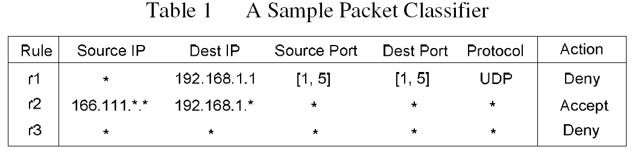
Introduction(2/2)
Rule r1, both the source port and destination port contain a range [1,5]. So both of them needs to be expanded to three prefixes, i.e., “001”, “01*”, “10*”. The combination of the prefix specifications of the two ranges will consume 3x3=9 TCAM entries, causing the well-known range expansion problem.

Slide 4
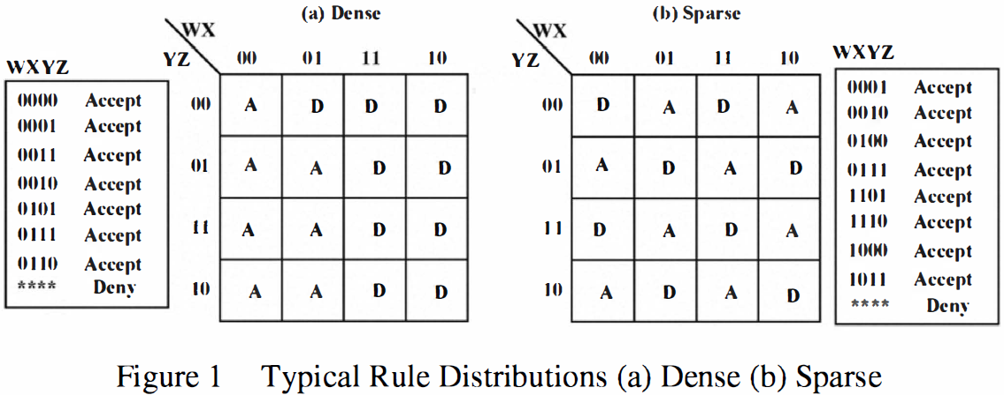
Related Work
In Figure 1 (b) spread sparsely and no two neighboring rule elements have the same action

Slide 5
Proposed Scheme(1/8)
Before introducing the algorithm of BP, we first define several terms and concepts below.
  Block Size : the number of wildcard ‘*’ in the Boolean
    representation.
  Distance : The number of different counterpart bits in their Boolean
  representations.
  EX: “0*01” and “01*0” is 1 , “0*01” and “0101” is 0.
  Direction : Boolean representations of two blocks have
  wildcards that all appear in the same bit positions
  EX: “0*01” and “0*10” in the same direction

Slide 6
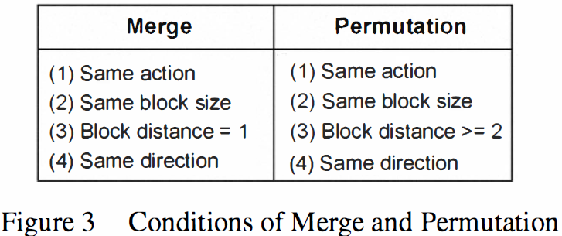
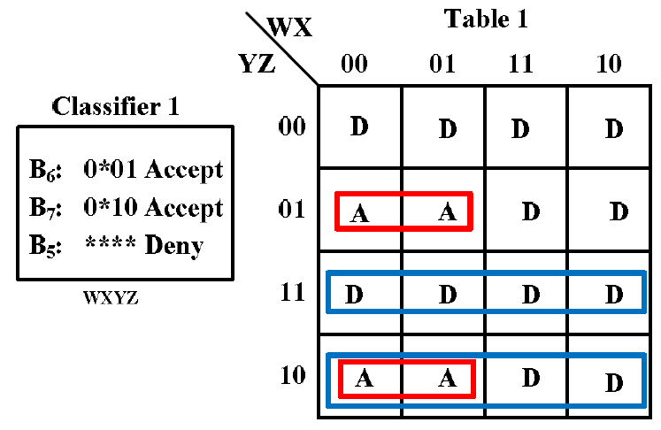
Proposed Scheme(2/8)
  Merge and Permutation
  Target Blocks and Assistant Blocks : A pair of target blocks is
  the two blocks that we target to merge by a permutation.
  EX :
B₆ and B ₇ are target block.
Notes:
target block : 紅色框起來的2個block
assistant Blocks : 藍色框起來的2個block

Slide 7
Proposed Scheme(3/8)
Original Table
Table 1
wx
wx
yz
00
01
11
10
yz
00
01
11
10
D | D | D | D
A | D | A | D
D | D | D | D
A | D | A | D
00
D | D | D | D
A | A | D | D
D | D | D | D
A | A | D | D
00
01
Exchange column
01 and 11
01
11
11
10
10
Original Classifier
Classifier 1
B1: 0001 Accept
B2: 1101 Accept
B3: 0010 Accept
B4: 1110 Accept
B5: **** Deny
B6: 0*01 Accept
B7: 0*10 Accept
B5: **** Deny

Slide 8
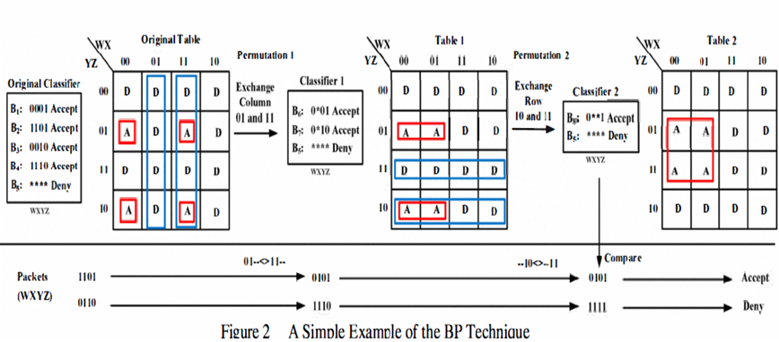
Proposed Scheme(3/8)

Slide 9
Proposed Scheme(4/8)
The BP has following properties :
  Property 1: The size of the assistant block cannot be smaller than the size of the corresponding target block.
  Wp >= Wt, Wp: the size of assistant block wildcards
  Wt: the size of target block wildcards
  Property 2: The size of the assistant block cannot be larger than the number of bits in a rule minus the distance between the two corresponding target blocks
  Wp <= (L - D), L: rule’s bits
  D: the distance of the two target blocks

Slide 10
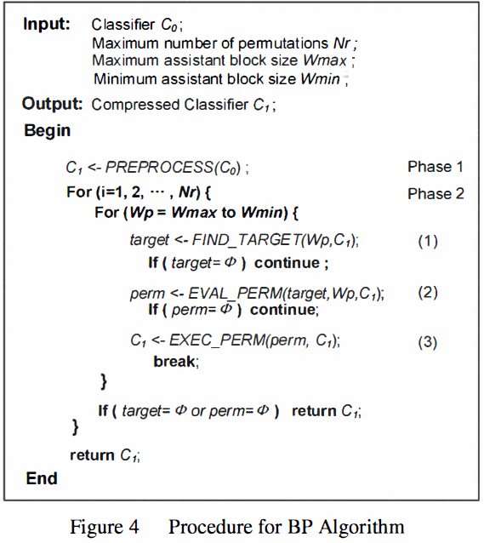
Proposed Scheme(5/8)
Wp : assistant block size
target : target block
perm : permutation
Notes:
Nr,Wmax,Wmin都是自己設定的
Preprocess phase會先將可能之後會合併的rule先group起來，這個動作是希望可以減少在phase2中要處理的rule

Slide 11
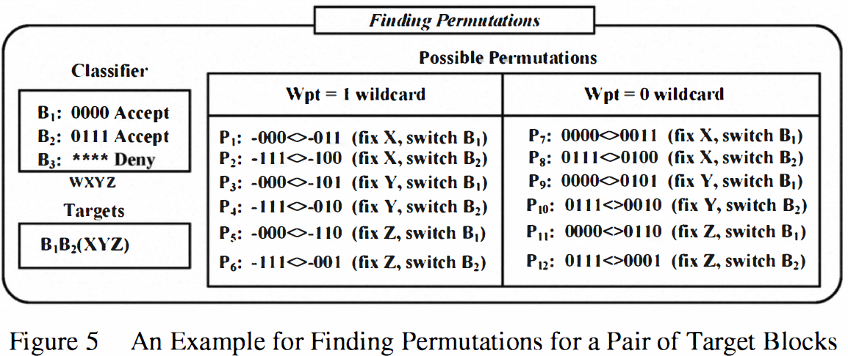
Proposed Scheme(6/8)
1.GET_TARGET : Try to find out all possible targets.
2.EVAL_PERM :Have two tasks.
  Search all possible permutations for the targets.
  Determine if these permutations are worth performing.
Select the “best” one to perform : the number of blocks reduced(r) minus the number of new blocks caused by the splitting of existing blocks(s).
=>r-s
Notes:
選擇最好的

Slide 12
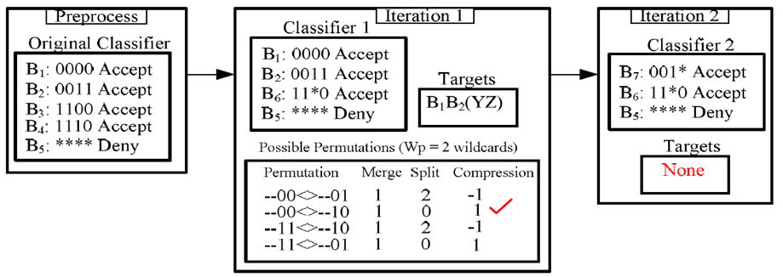
Proposed Scheme(7/8)
3. PERFORM : perform the permutation that has been selected in the step of EVAL_PERM to merge the target blocks.
Notes:
Compression就是剛剛說的merge後的產生的blocks數-有被拆開的block

Slide 13
Proposed Scheme(7/8)
Table 1
wx
Table 1
yz
00
01
11
10
wx
1
 |  | 6
1 |  | 6
yz
00
01
11
10
00
00
 |  | 6
1
1 |  | 6
01
Exchange row
01 and 11
01
11
11
10
10
Classifier 2
B1: 0000 Accept
B2: 0011 Accept
B6: 11*0 Accept
B5: **** Deny
Classifier 1
B6: 1100 Accept
B6: 1101 Accept
B7: 00*1 Accept
B5: **** Deny
1 – 2 = -1
Notes:
Compression就是剛剛說的merge後的產生的blocks數-有被拆開的block

Slide 14
Proposed Scheme(7/8)
Table 1
wx
Table 1
yz
00
01
11
10
wx
1
 |  | 6
1 |  | 6
yz
00
01
11
10
00
00
1 |  | 6
1 |  | 6
01
Exchange row
00 and 10
01
11
11
10
10
Classifier 2
B1: 0000 Accept
B2: 0011 Accept
B6: 11*0 Accept
B5: **** Deny
Classifier 1
B6: 11*0 Accept
B7: 00*1 Accept
B5: **** Deny
1 – 0 = 1
Notes:
Compression就是剛剛說的merge後的產生的blocks數-有被拆開的block

Slide 15
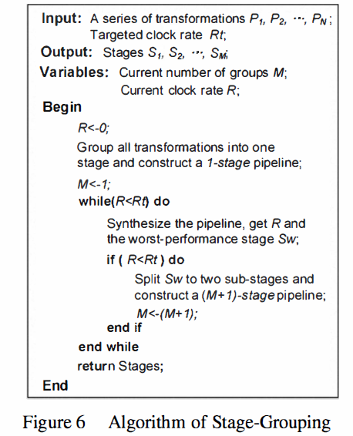
Proposed Scheme(8/8)

Slide 16
EXPERIMENTAL(1/3)
Environment
CPU | Intel E5335
Frequency | 2.0GHz
OS | Linux
Environment
FPGA | Altera Cyclone III

Slide 17
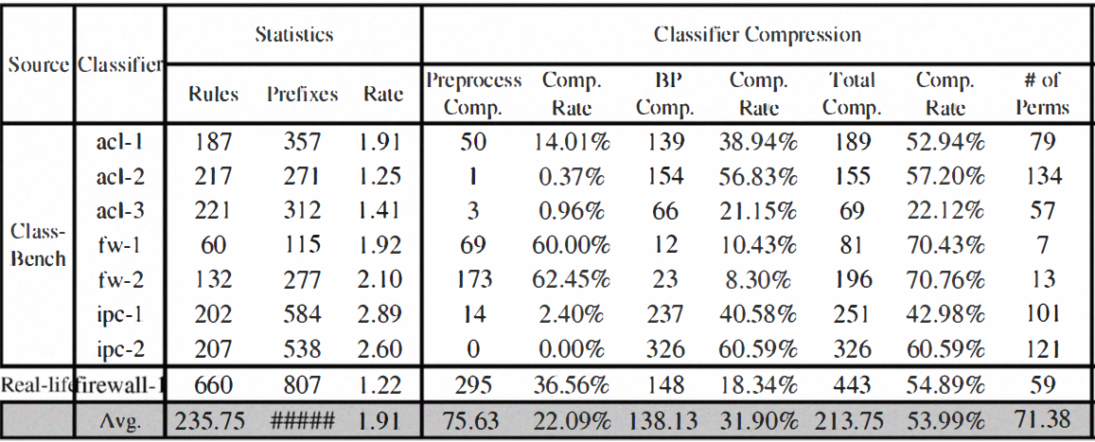
EXPERIMENTAL RESULTS(2/3)

Slide 18
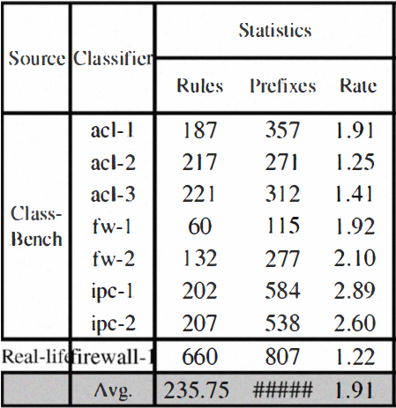
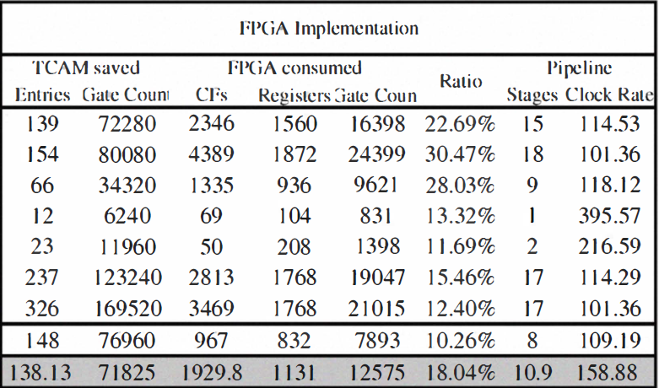
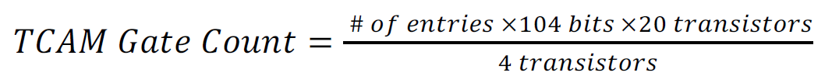
EXPERIMENTAL RESULTS(3/3)

